Slide 1
Bypassing Tunnels: Leaking VPN Client Traffic by Abusing Routing Tables
Nian Xue*, Yashaswi Malla⁺, Zihang Xia⁺, Christina Po ̈pper⁺
Mathy Vanhoef&
*New York University, ⁺New York University Abu Dhabi,
&imec-DistriNet, KU Leuven

Slide 2
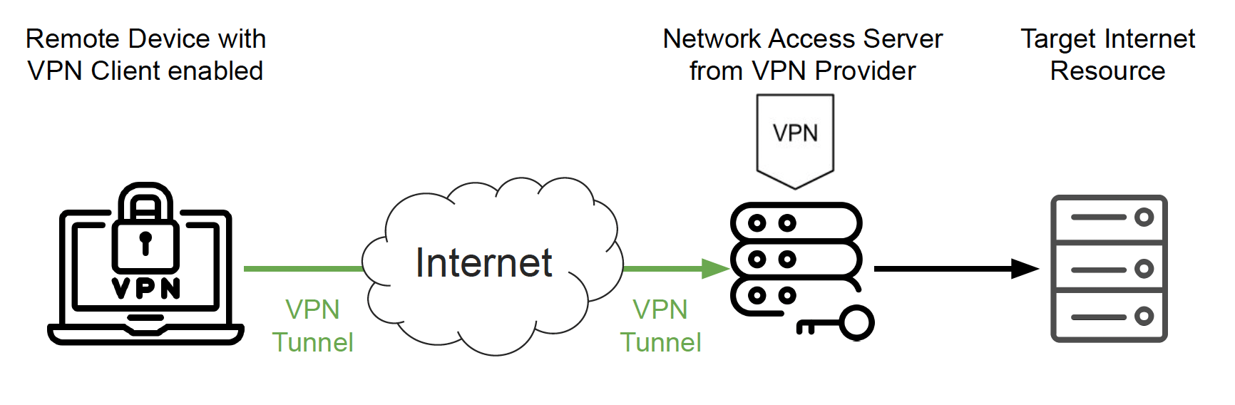
Internet With VPN
Encrypted Internet Traffic

Slide 3
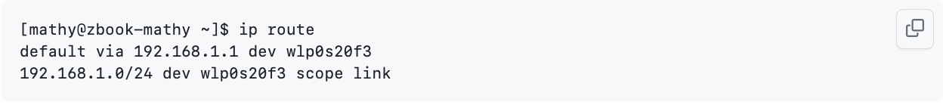
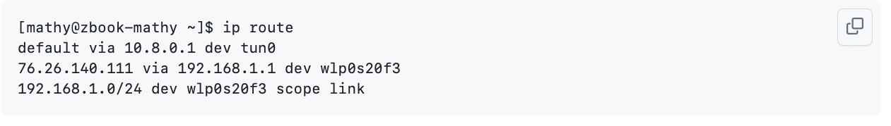
How VPN Works?
ServerNet Attack
LocalNet Attack

Slide 4
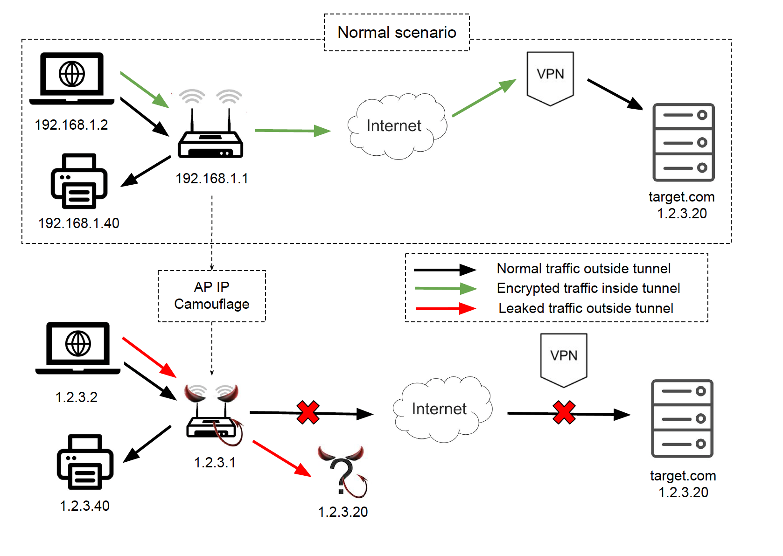
LocalNet Attack

Slide 5
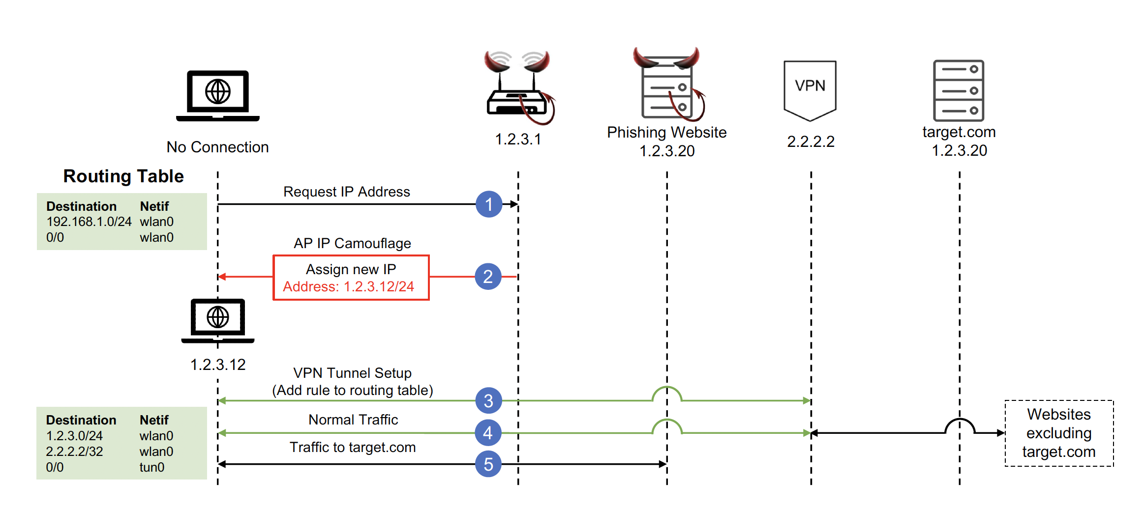
LocalNet Attack

Slide 6

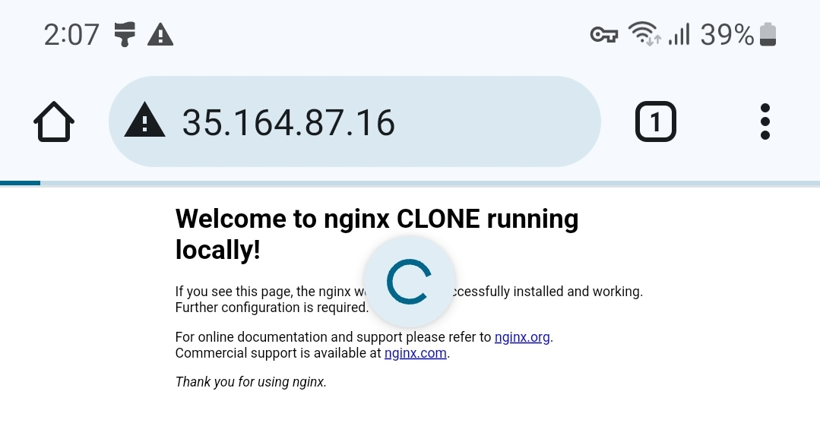
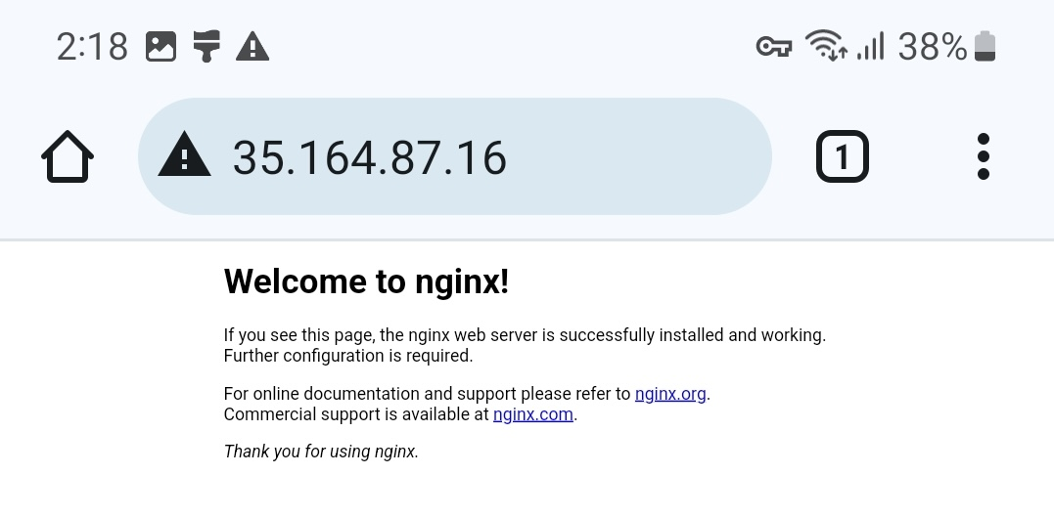
LocalNet Attack: My Setup

Slide 7
Setup Issues:
Broadcom wifi chips can cause kernel panic
When it is used in ap mode and station mode at the same time
Solution: Had to get a small network card

Slide 8
LocalNet Attack Summary
VPN | OS | Result
Hide.Me 4.1.x | Android 13 | Leaking when local network connection enabled
Hide.Me 5.0.1 | iOS 17.1.2 | Leaking
Hide.Me | Windows 10 | Sends ARP request then blocks local connection
Hide.Me 5.2.2 | Mac 14.1 | Leaking
Hotspot Shield | iOS 17.1.2 | Leaking
Hotsport Shield | Andoird 13 | Not Leaking
Hotspot Shield | Windows 10 | Leaking
Hotspot Shield | Mac 14.1 | Leaking
VPN Unlimited (Paid) | iOS 17.1.2 | Leaking

Slide 9
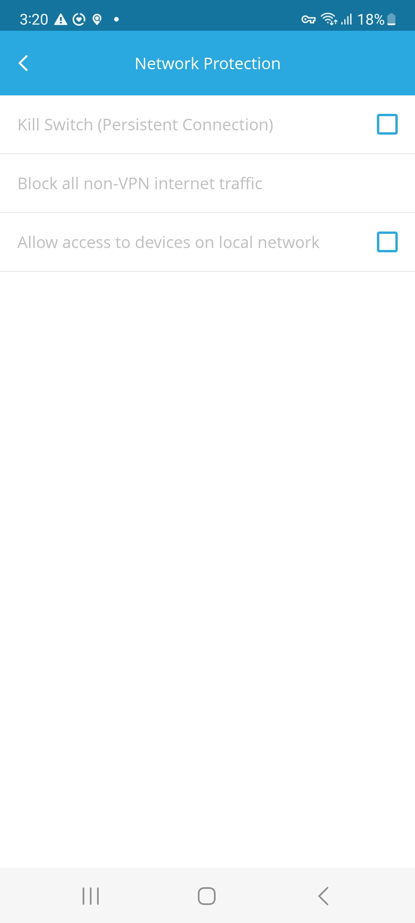
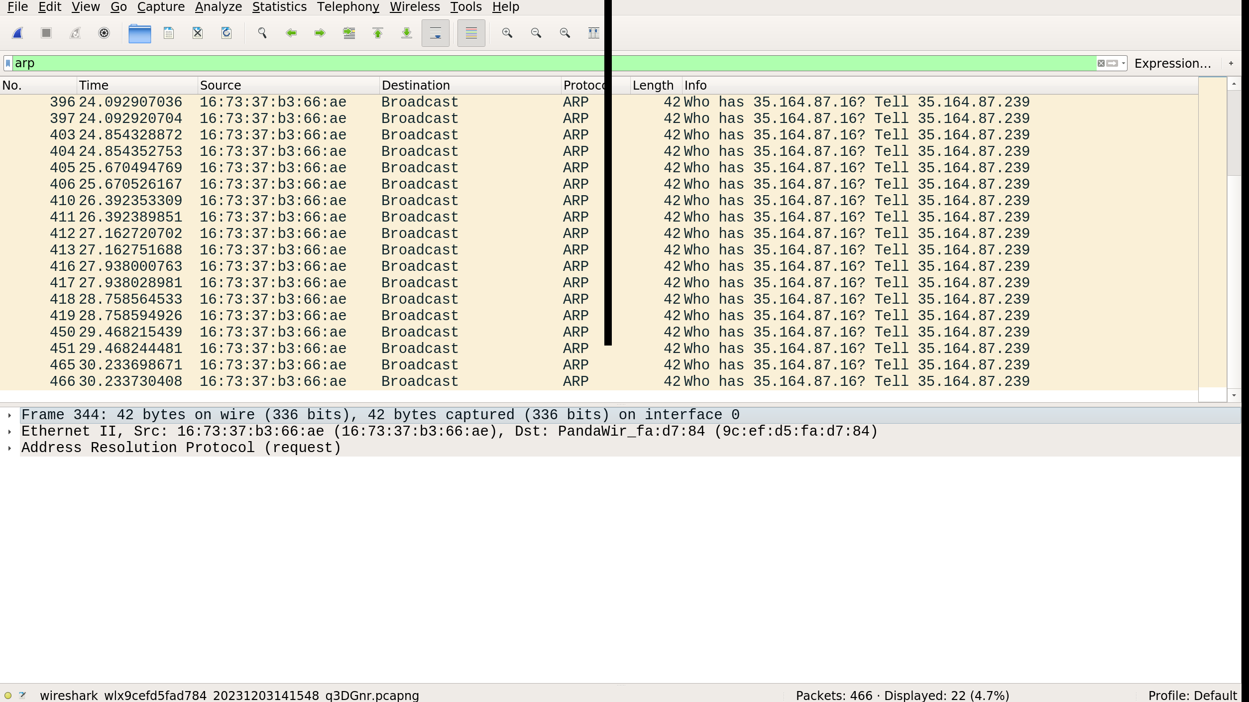
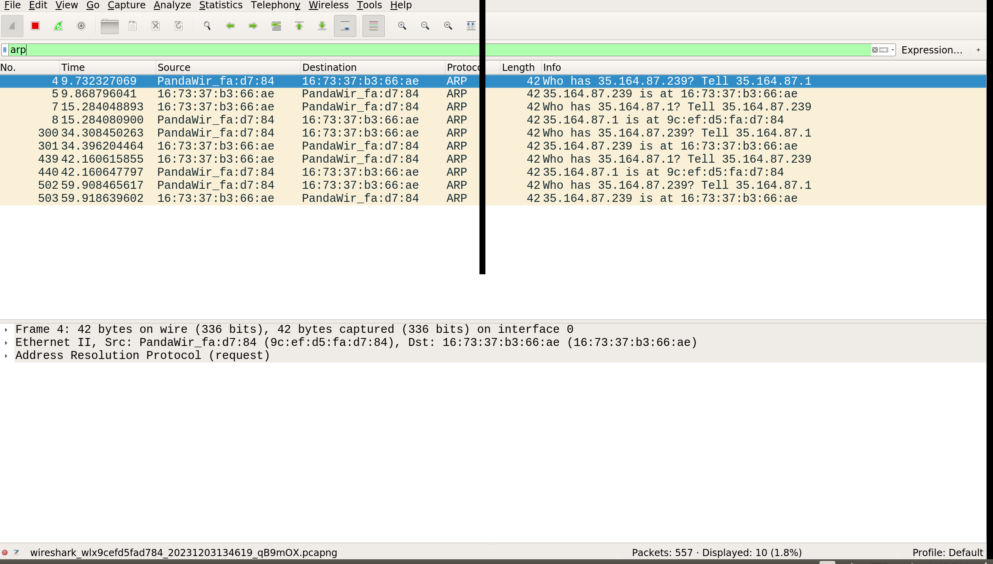
HideMe 4.1.x + Android 13

Slide 10
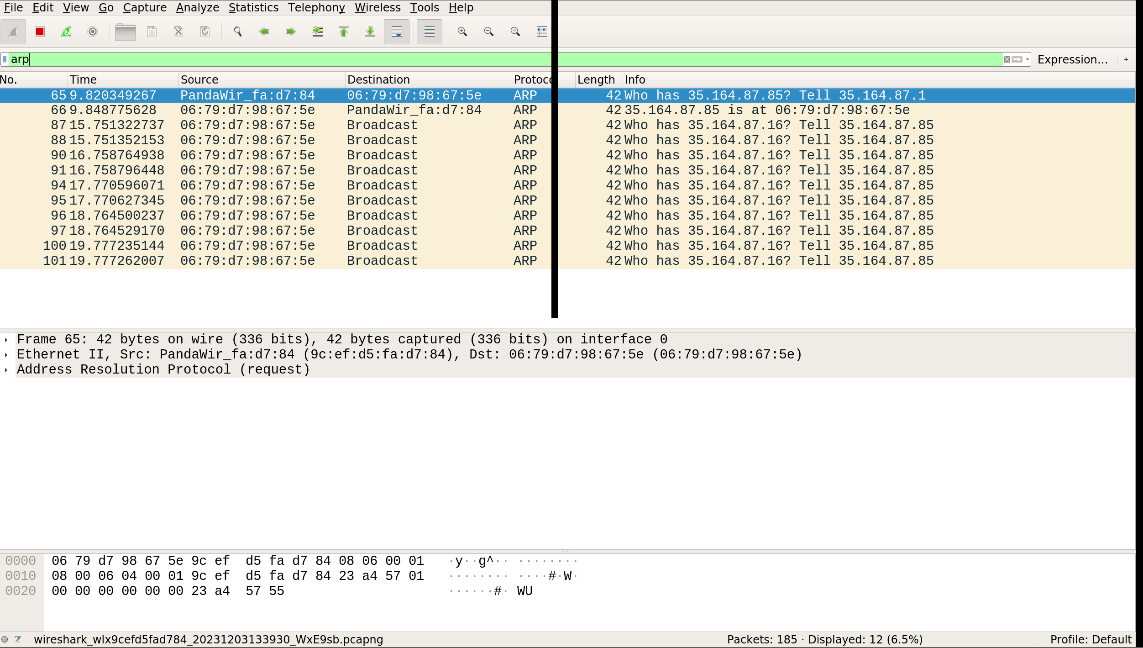
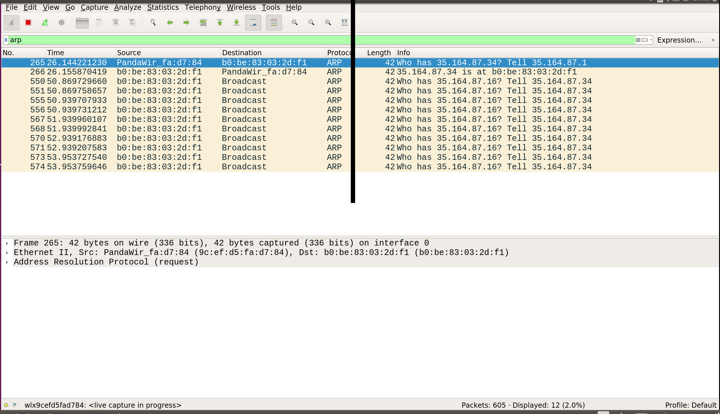
Hide.Me on iOS and Mac

Slide 11
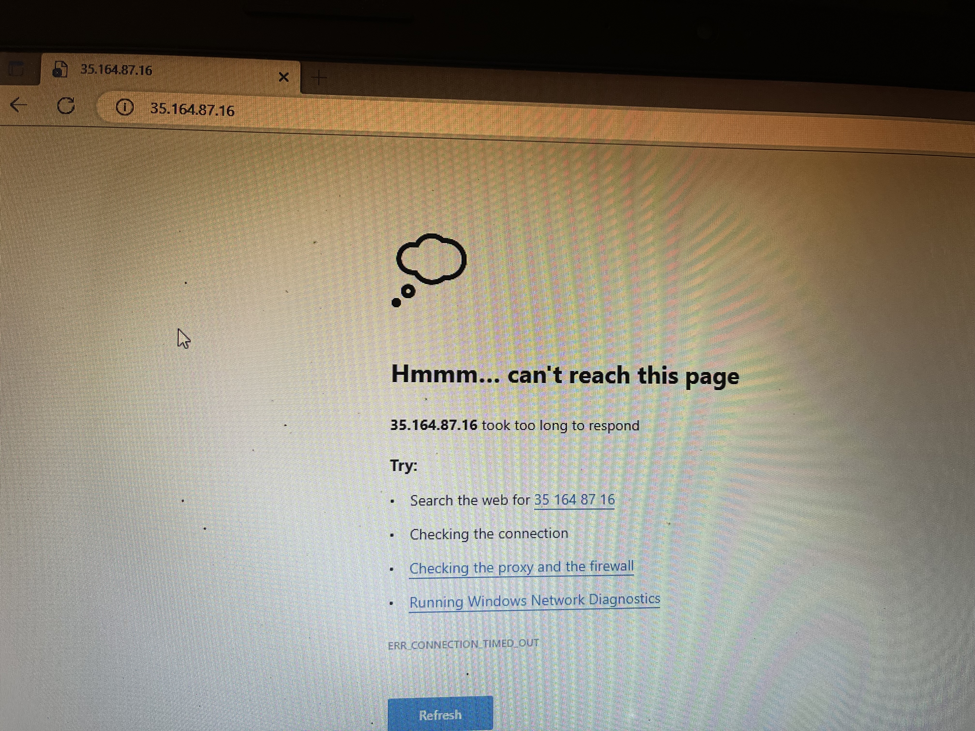
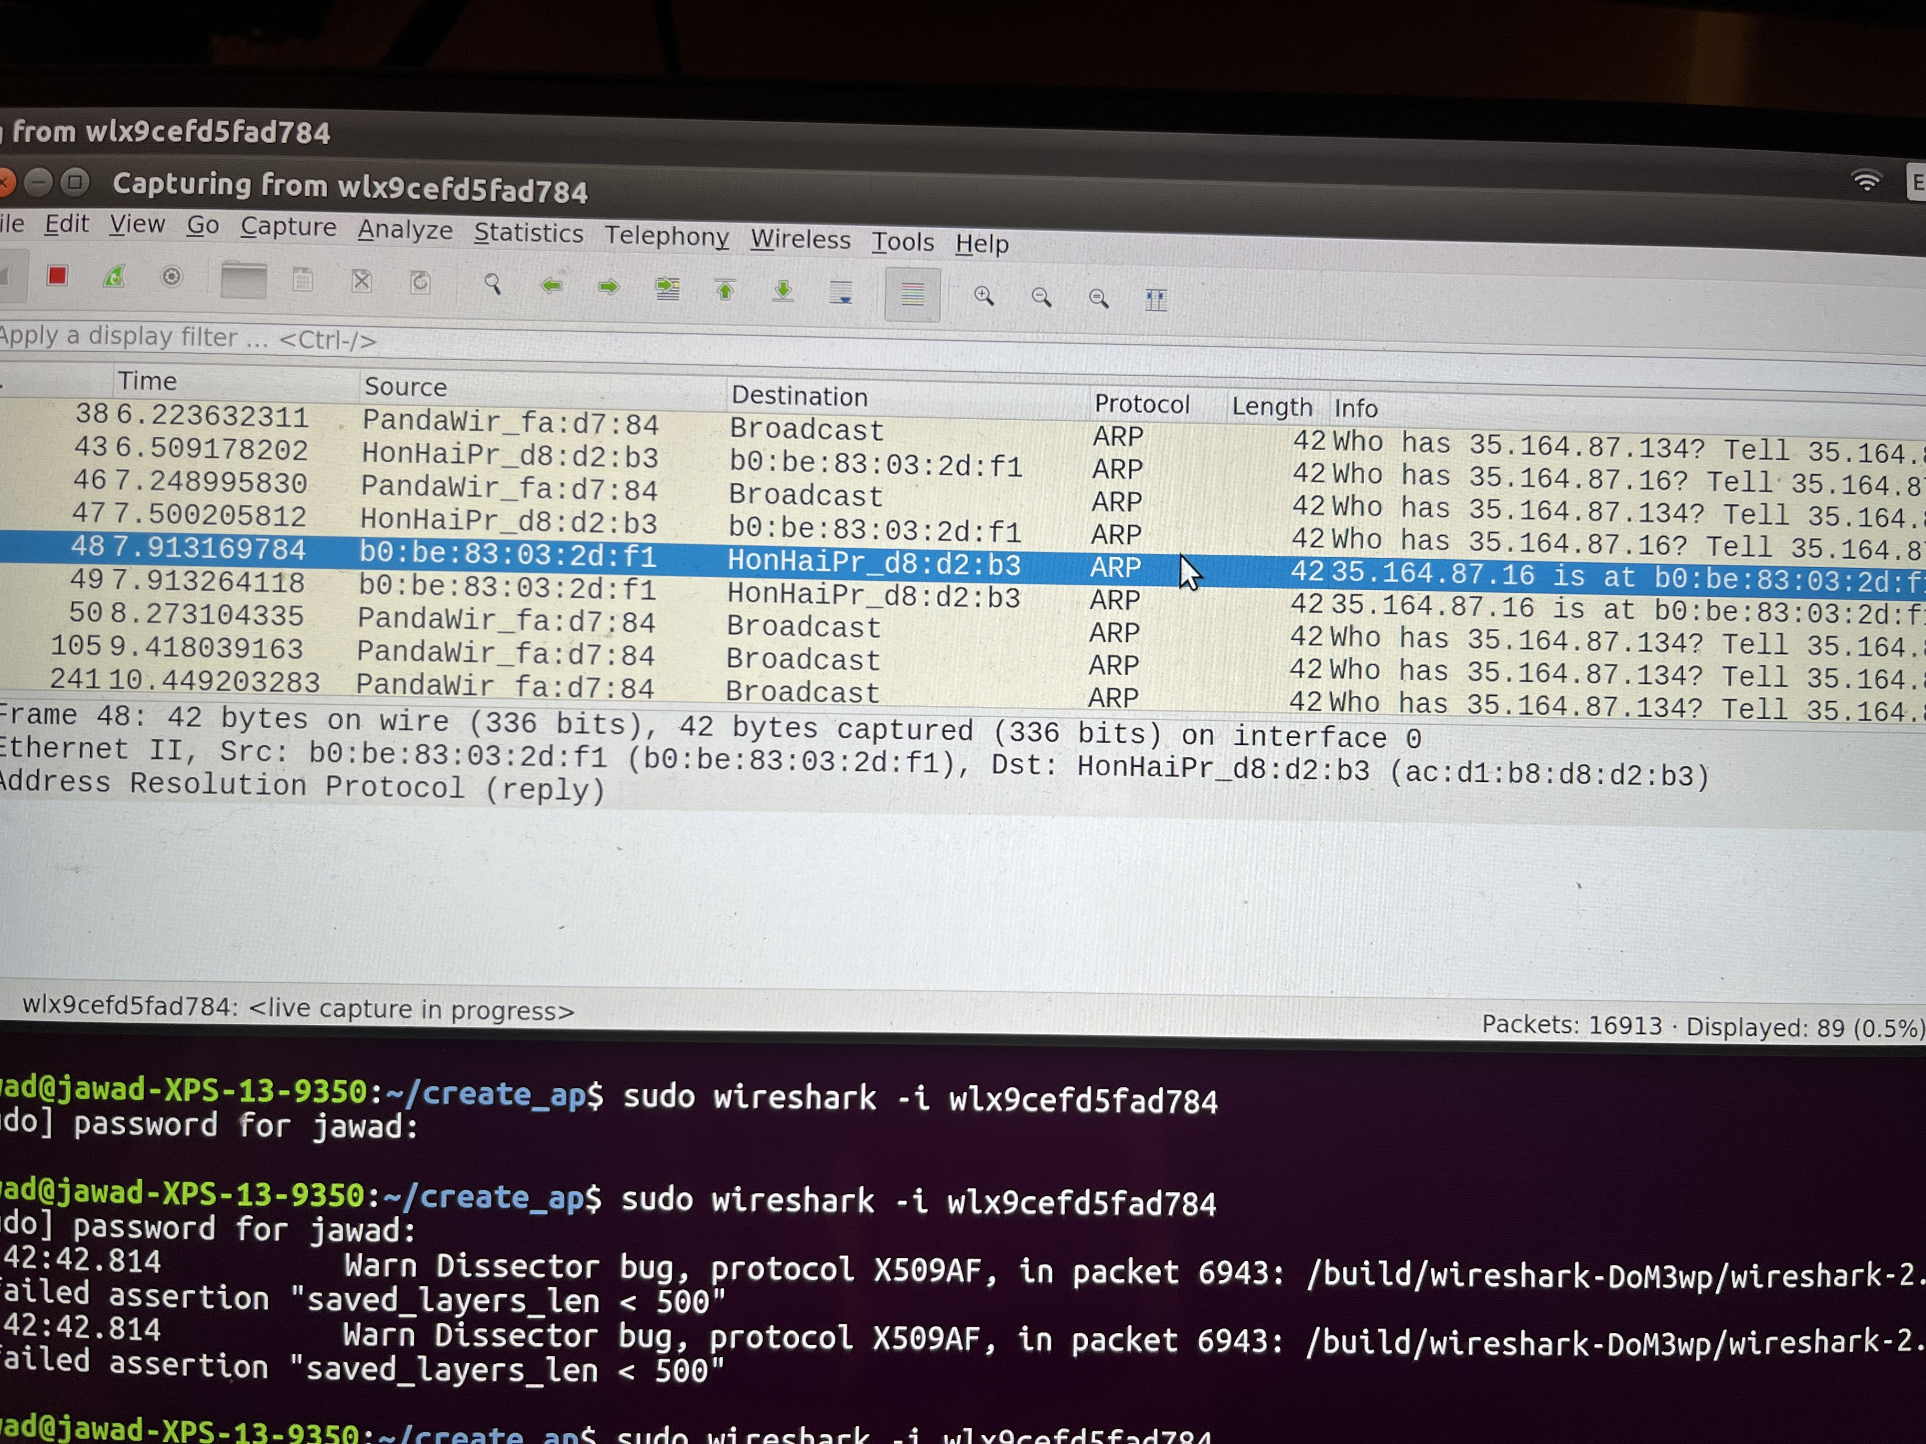
Hide.Me Windows

Slide 12
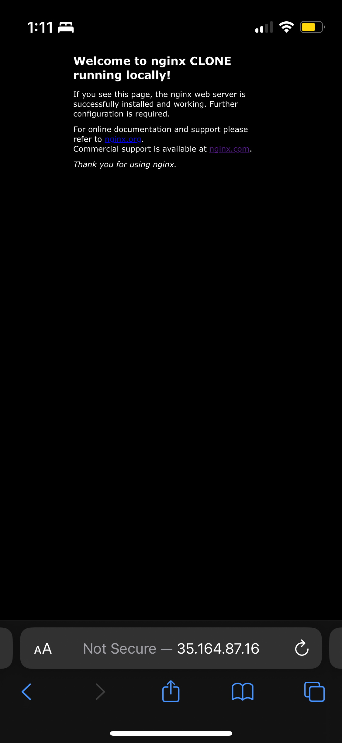
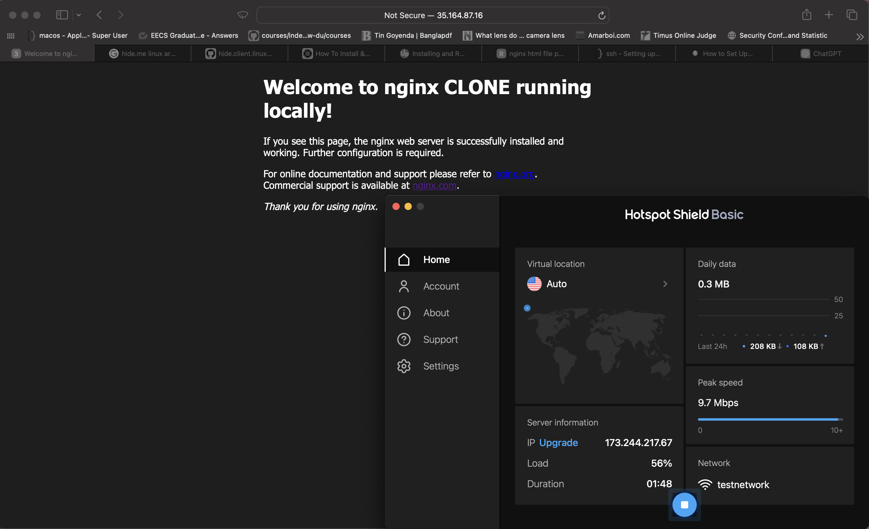
Hotspot Shield on Mac and iOS

Slide 13
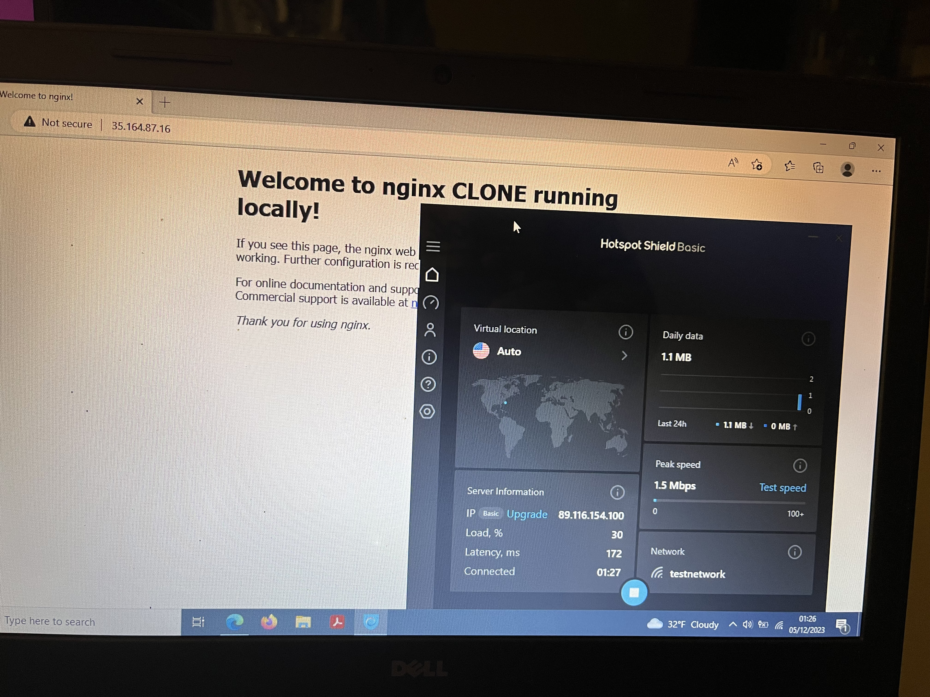
Hotspot Shield on Windows

Slide 14
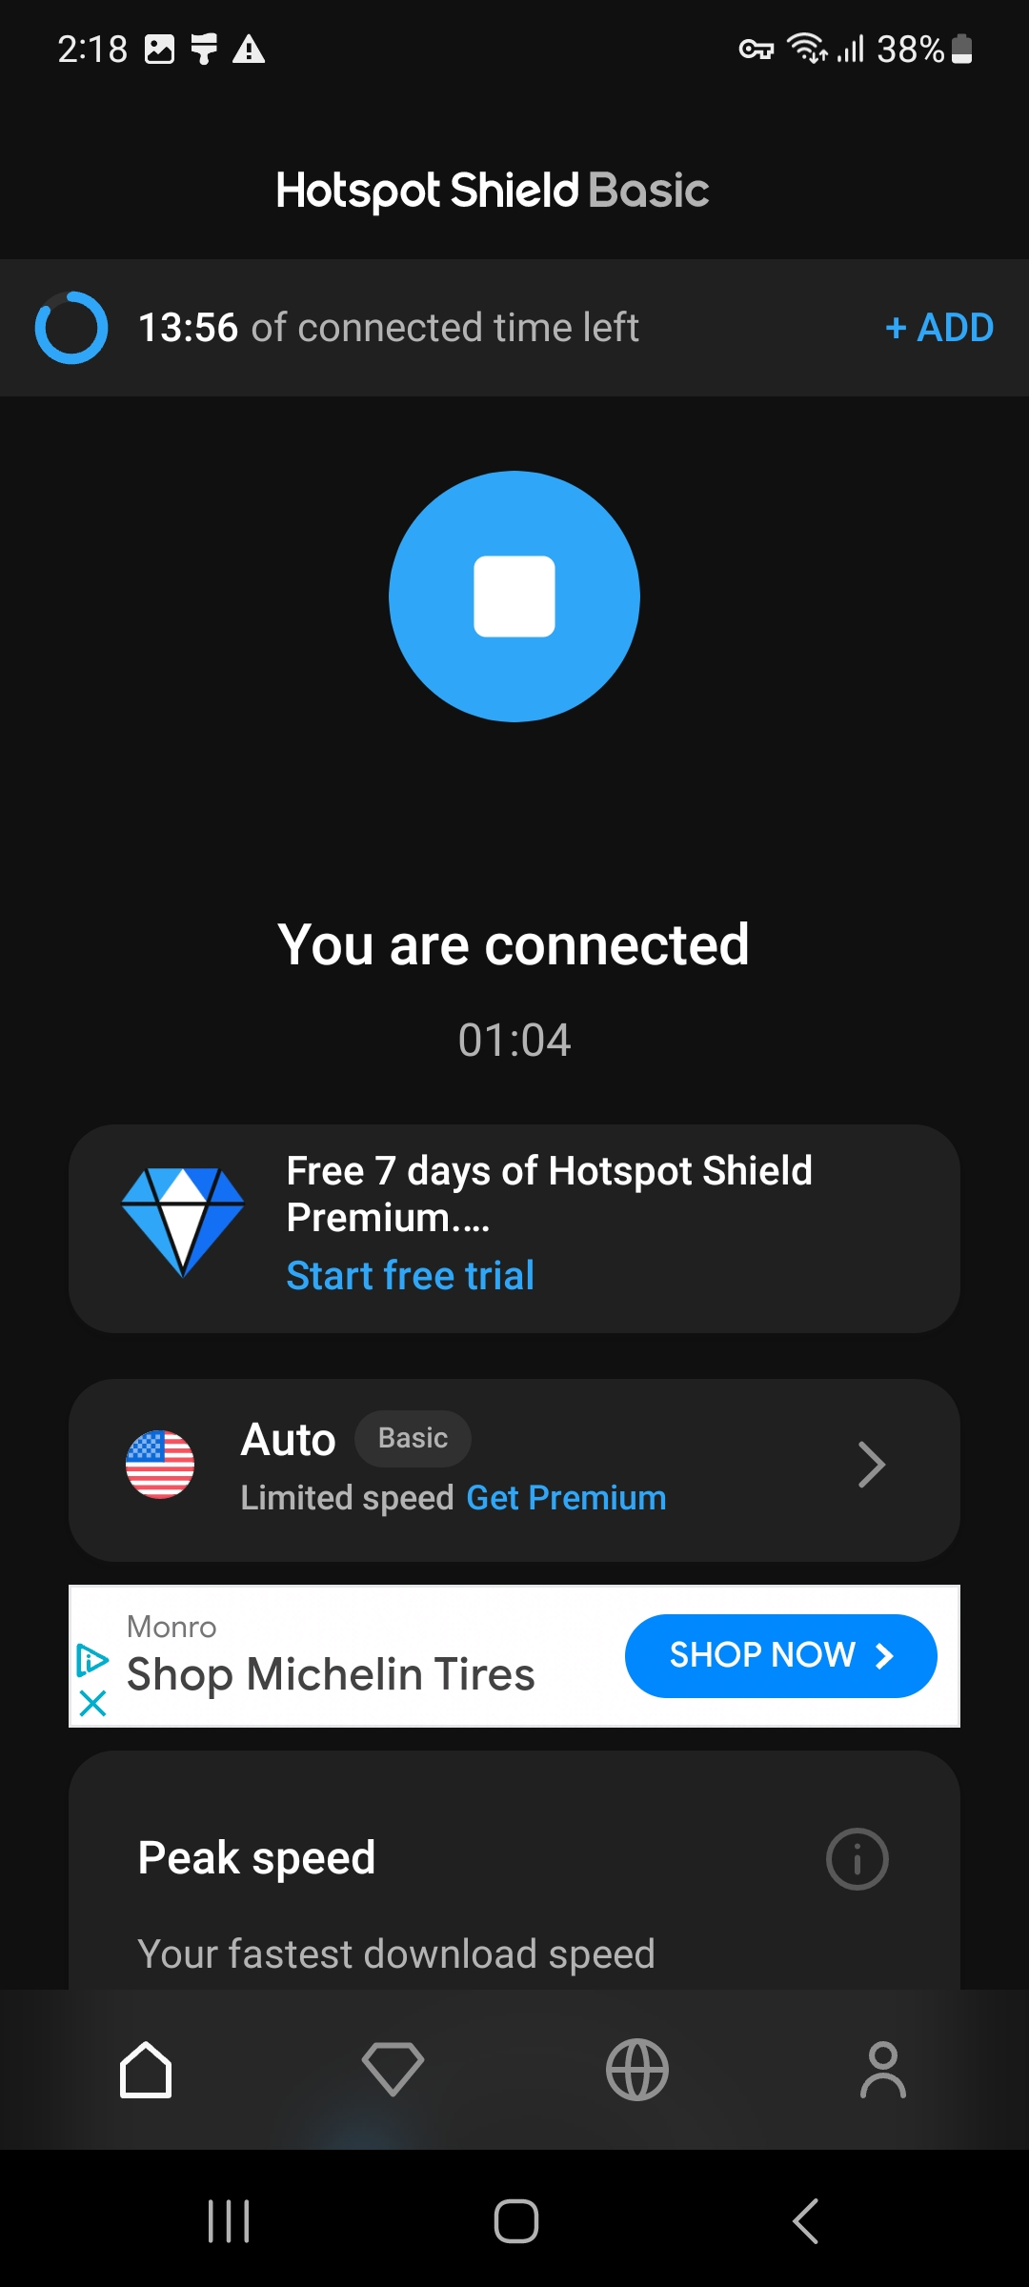
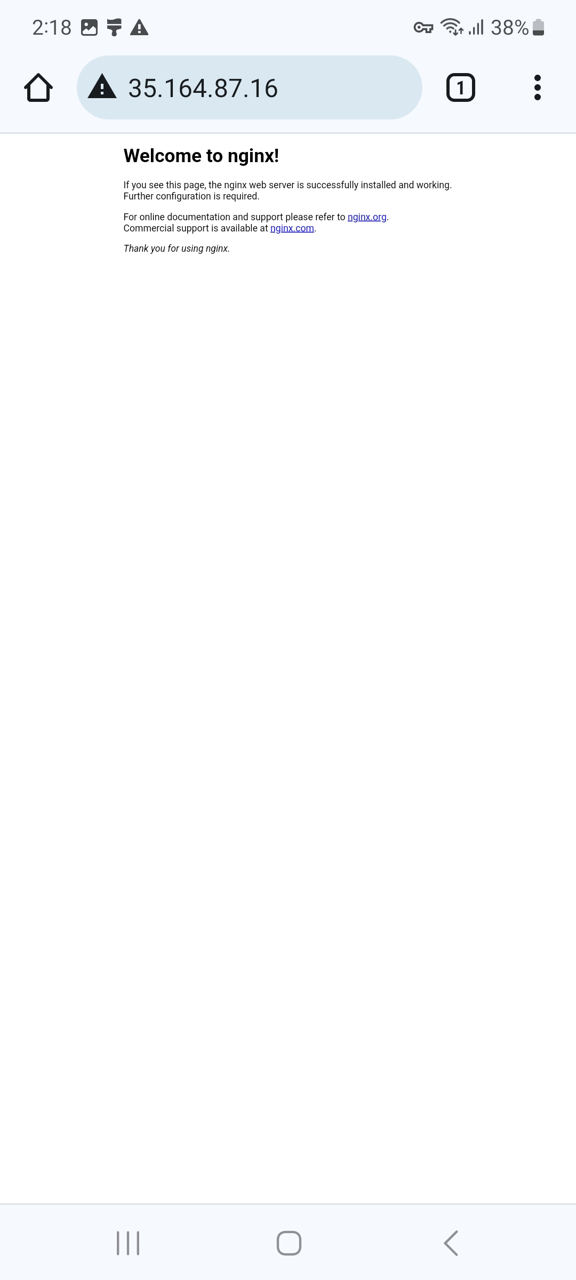
Hotspot Shield on Android

Slide 15
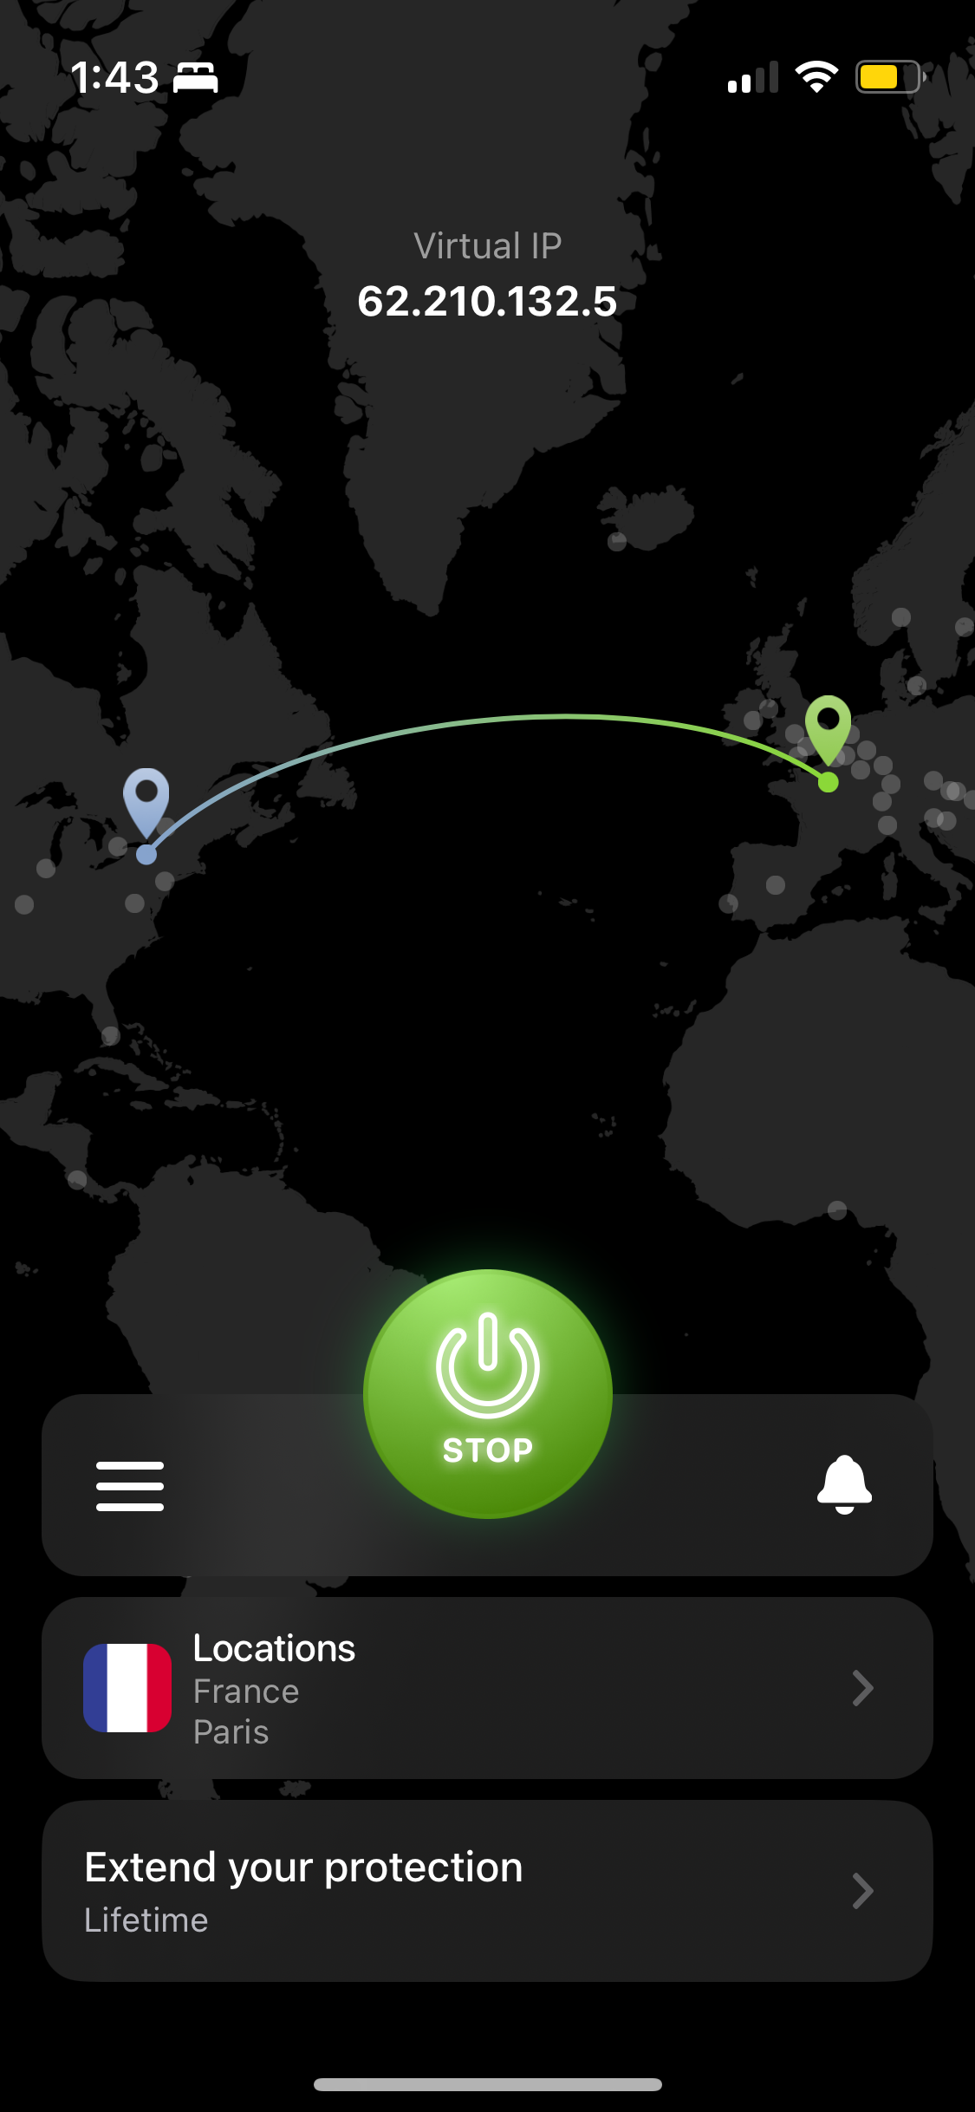

VPN Unlimited (Non-Free version) on iOS

Slide 16
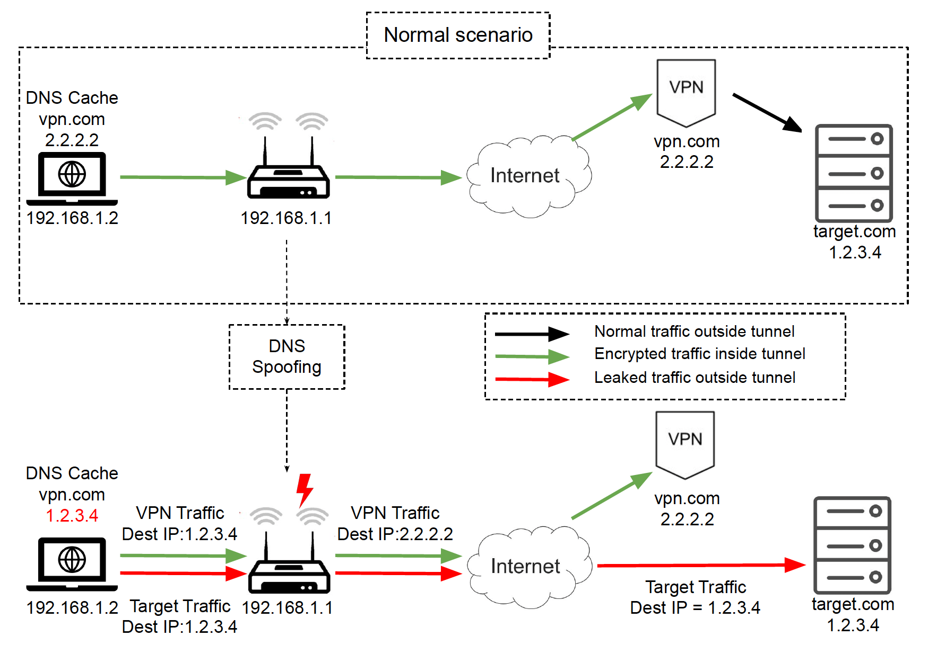
ServerIP Attack

Slide 17
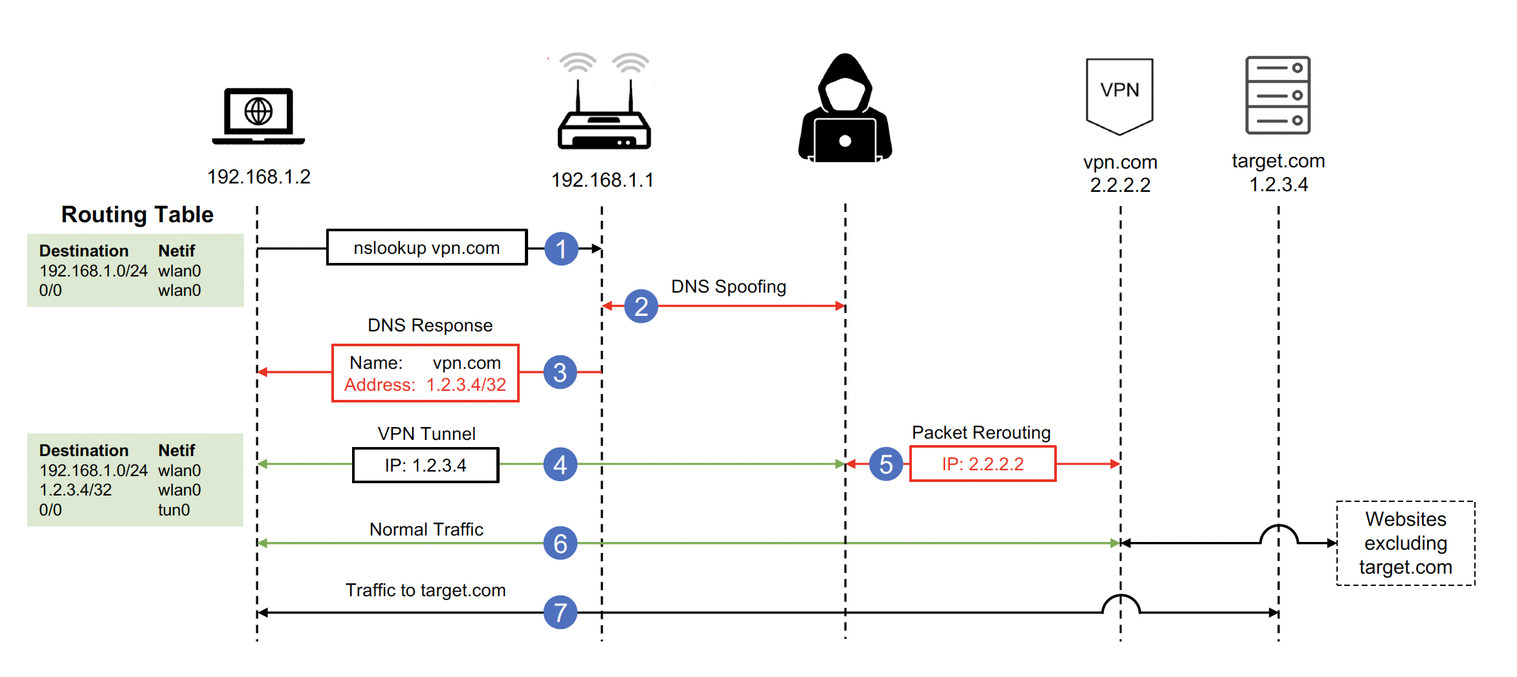
ServerIP Attack

Slide 18
My Setup
Most of the custom VPN apps are secure
Do not use DNS to look up the VPN server’s IP address
Tested OS built-in VPN clients with various vpn profiles
Only VPN Gate was the free VPN provider

Slide 19
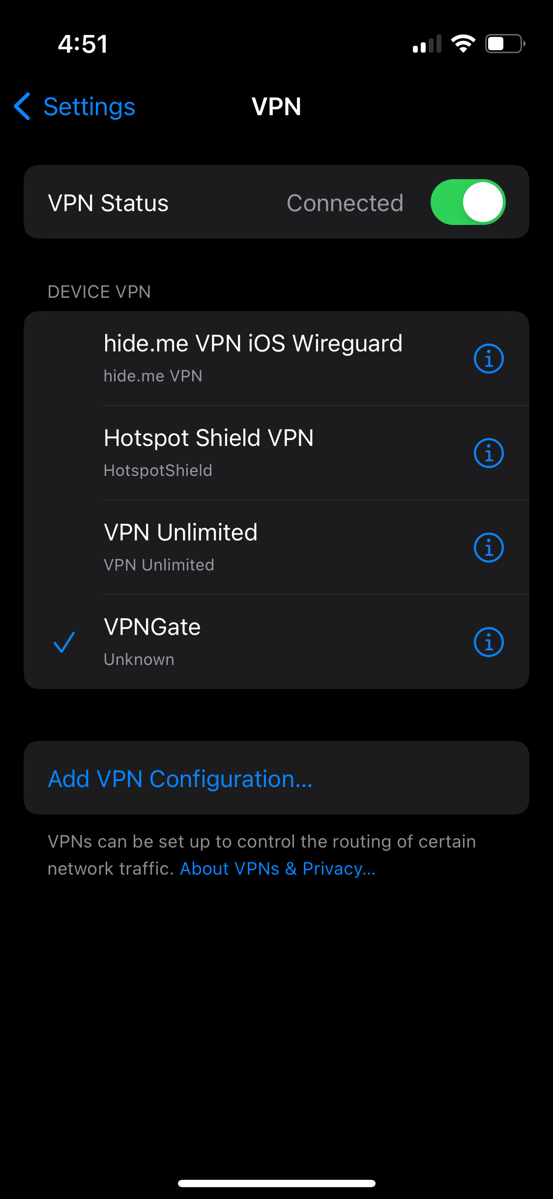
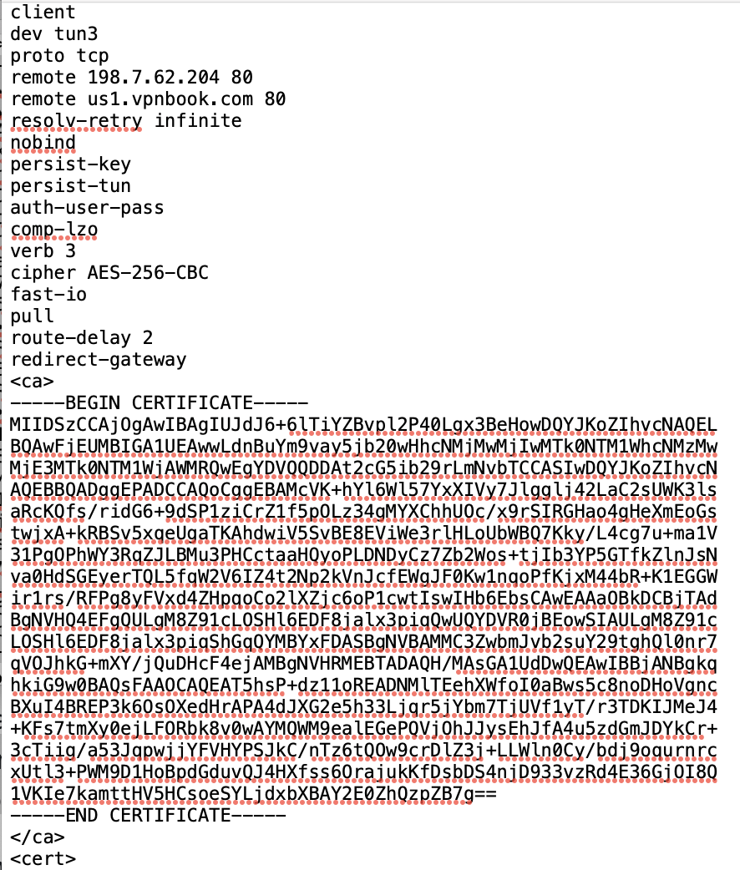
New Info: VPN profiles

Slide 20
How to test?
“test whether the VPN client used plaintext DNS to find the VPN server's IP address. To determine this, you can use the Wireshark filter dns.a == $VPN_SERVERIP. If you see any results, then the VPN client is highly likely to be vulnerable.”
VPN Client | Provider | Result
iOS Built-in | VPN Gate | Leaking
Android Built-in | VPN Gate | Leaking
Mac Built-in | VPN Gate | Leaking

Slide 21
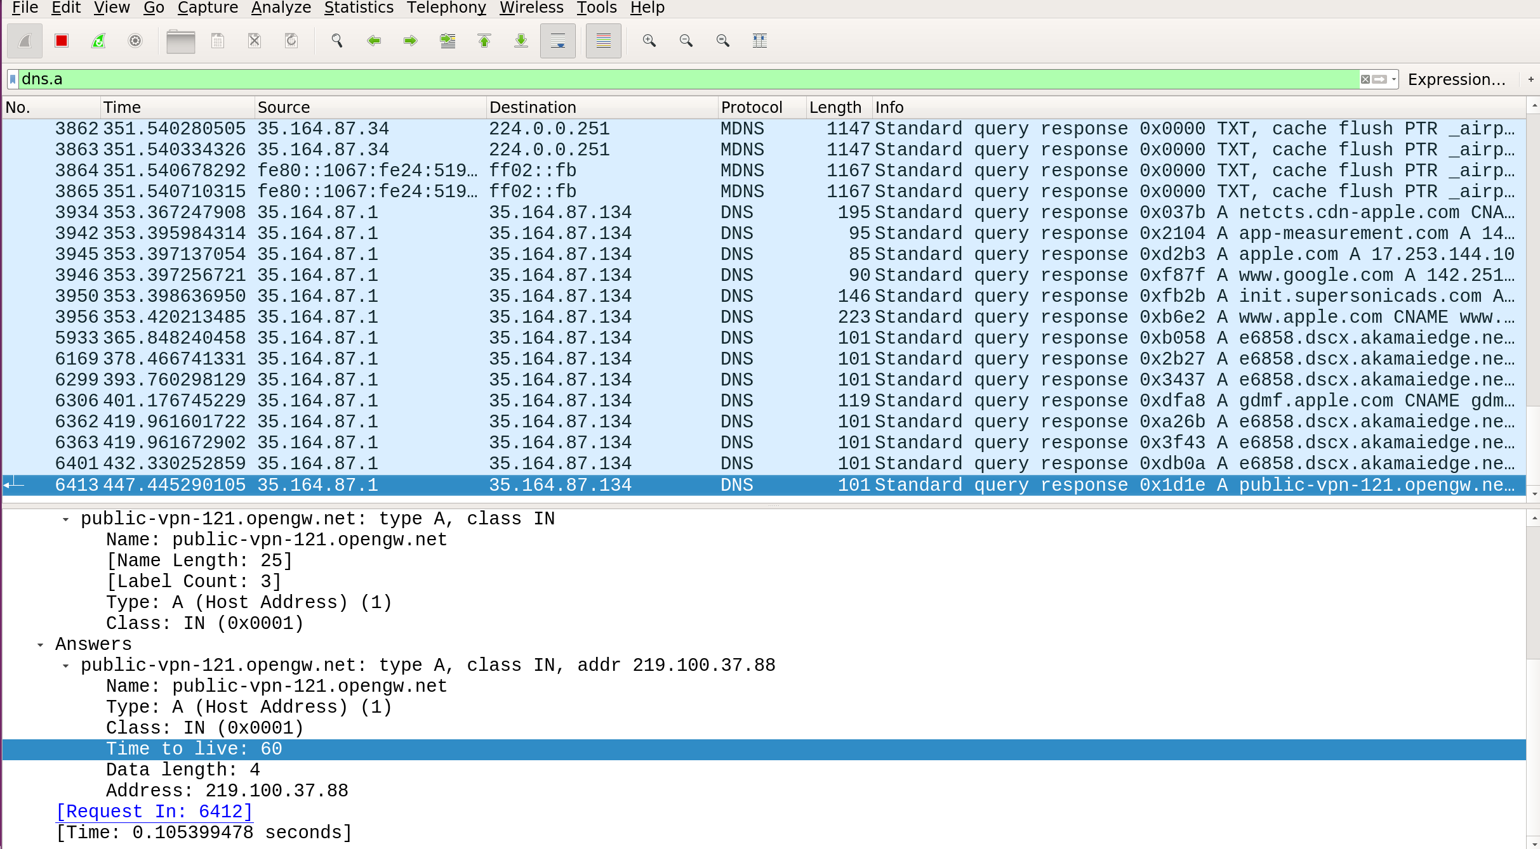
ServerNet Attack iOS

Slide 22
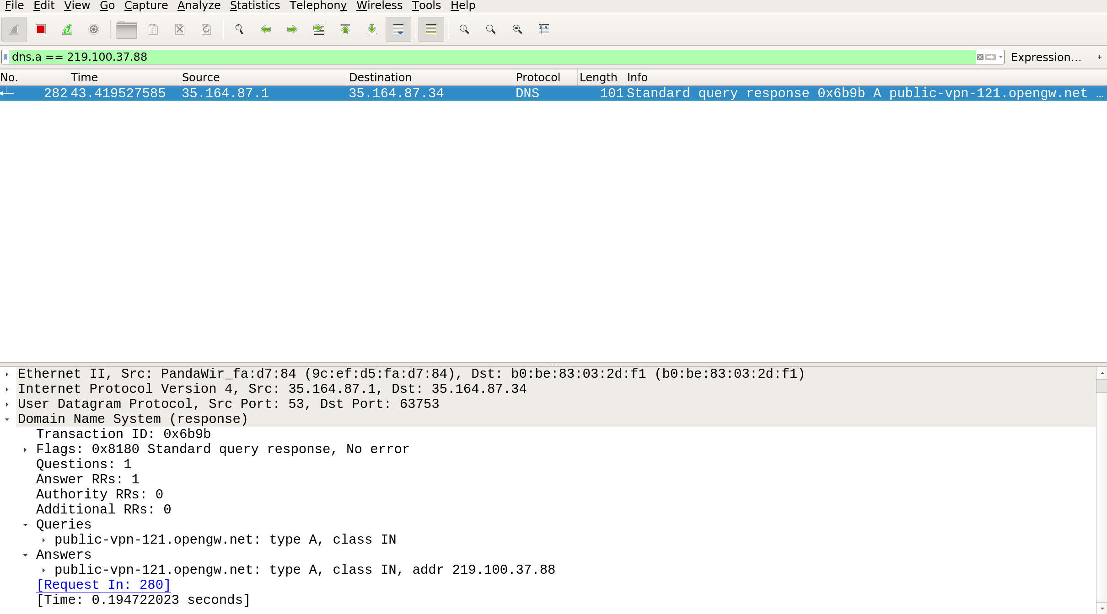
ServerNet Attack Mac

Slide 23
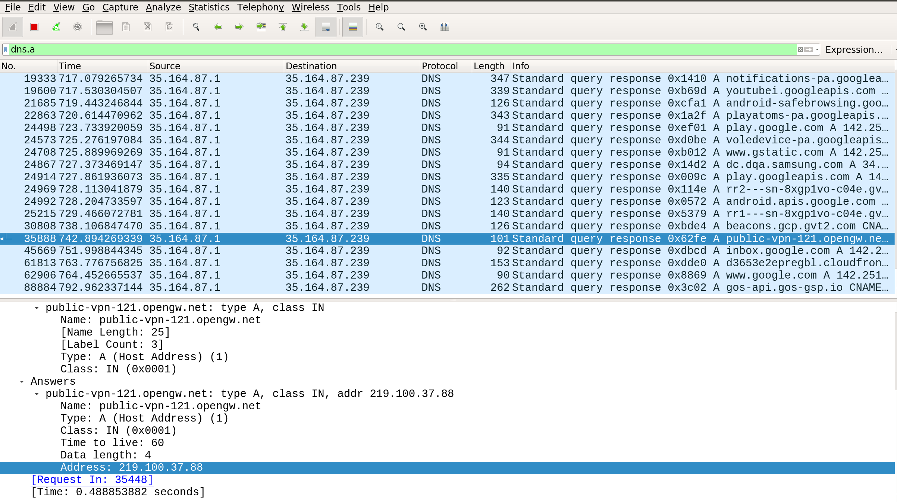
ServerNet Attack Android

Slide 24
Summary
Tried to reproduce all categories of result from the paper
Leaking
Not Leaking
Conditionally Leaking
Leaking IP but blocking traffics
Did complete what was mentioned in the proposal
Was not able to complete the DNS spoofing for ServerNet Attacks

Slide 25

Question
Thank you

Slide 26
Original Test Subjects: LocalNet Attacks
63 VPN Clients
42 Android VPN clients
46 iOS Clients
39 Windows Clients
40 MacOS Clients
28 Linux Clients

Slide 27
Original Test Subjects: ServierIPAttacks
17 VPN apps
10 Android apps
5 iOS apps
11 Windows apps
10 macOS apps
17 Linux apps

Slide 28
My Plan
LocalNet Attacks:
Cisco Anyconnect on Linux, MacOS, iOS, Android (Week 8,9)
Hide.me VPN on Linux, MacOS, iOS, Android (Week 10, 11)
OpenVPN cli on Linux (Week 11)
VPN hostspot on macOS (Week 11)
ServerIP Attacks:
OpenVPN cli on Linux (Week 12, 13)
Presentation (Week 13)
Demo (Week 14)

